Slide 1
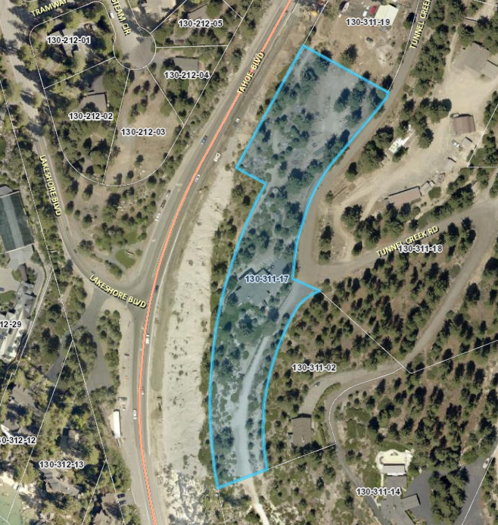
WSUP19-0006 (Verizon Monopole)
Washoe County Board of Adjustment
December 5, 2019

Slide 2
Request
This is Special Use Permit (SUP) to allow for the construction of a new wireless cellular facility consisting of a 45-foot high stealth monopine structure
The tower is proposed to be located on a 3 acre parcel in Incline Village, east of the intersection of Lakeshore Blvd. and Tahoe Blvd.
Washoe County Code (WCC) 110.324.50(e) requires a SUP for a monopole antenna

Slide 3
Site Characteristics
The parcel has a regulatory zoning of Low Density Suburban (LDS) and Tourist Commercial (TC)
The tower and equipment will be located on the southern portion of the parcel that is zoned LDS
There is a 4,214 sq. ft. residence on the northern portion of the parcel
To the west is Tahoe Blvd/State Route 28 and the parcels to the east are zoned LDS and to the south the parcel is zoned General Rural (GR), where the Tunnel Creek Trail is located

Slide 4
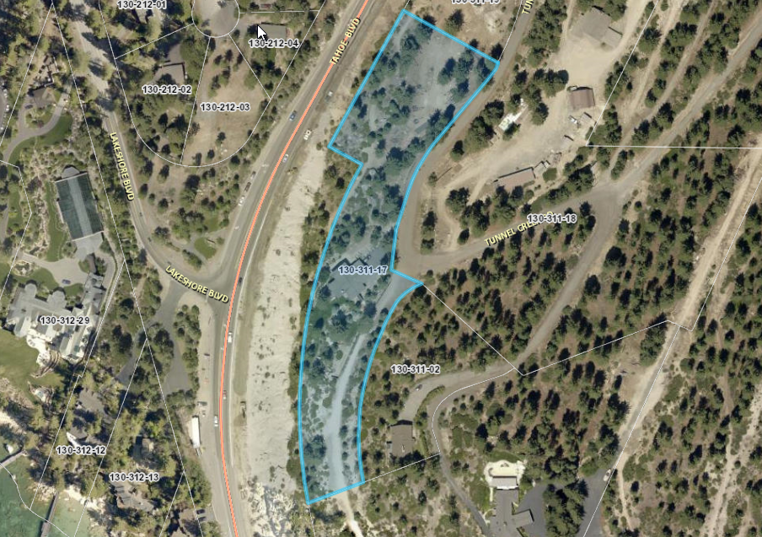
Residence
Location of tower and wireless equipment

Slide 5
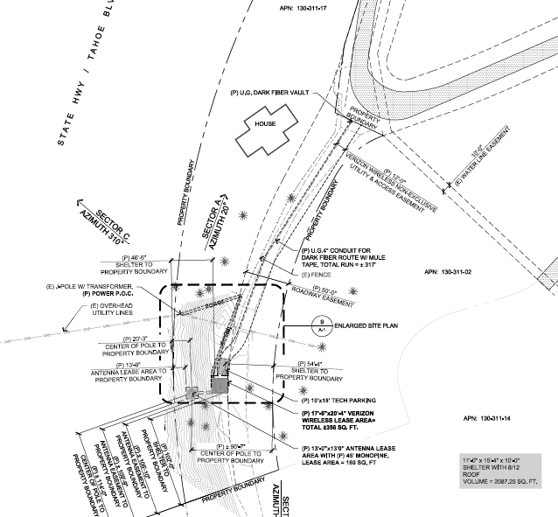
Site Layout

Slide 6
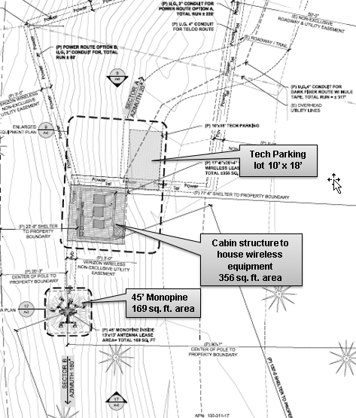

Slide 7
Analysis
The 40-foot tall monopine will be topped with a 5 foot crown, with a total height of 45 feet
The monopine will be equipped with 6 antennas, which will be used only by Verizon
A building that is designed as a log cabin will house the wireless equipment
The area for the monopine is 169 sq. ft. and the cabin area is 356 sq. ft. with a total square footage of the facility is 525 sq. ft.
The applicant is requesting to vary the landscaping requirements and not landscape the site, there are several large trees where the tower will be located

Slide 8
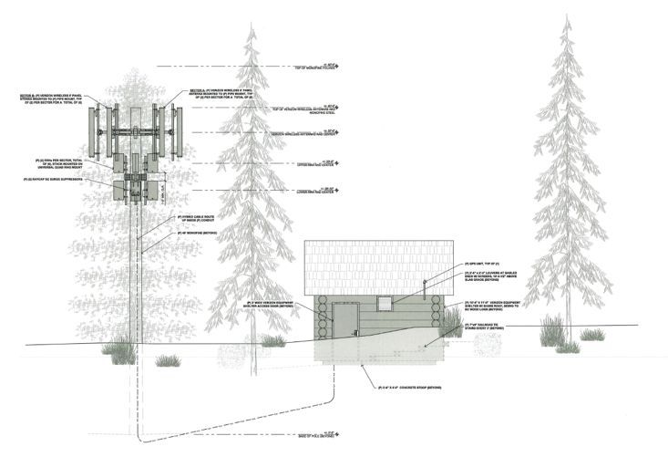

Slide 9
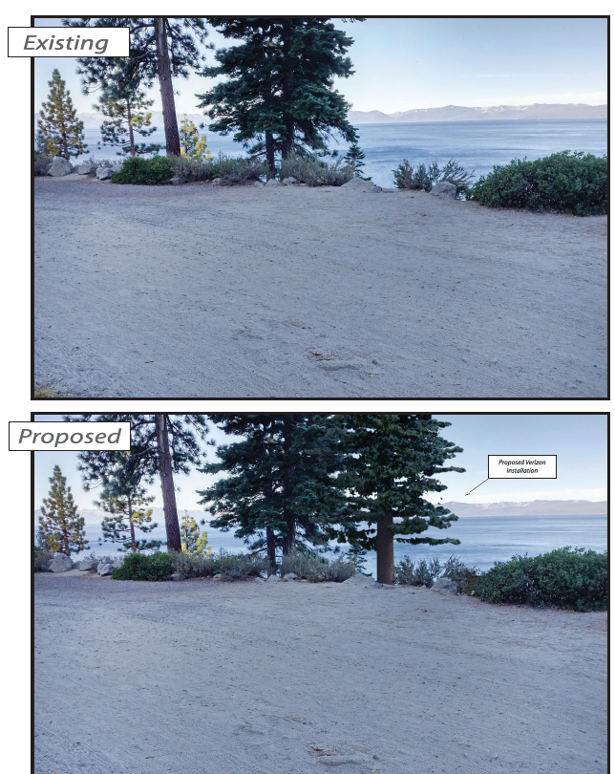
View from Tunnel Creek Rd. - looking southwest

Slide 10
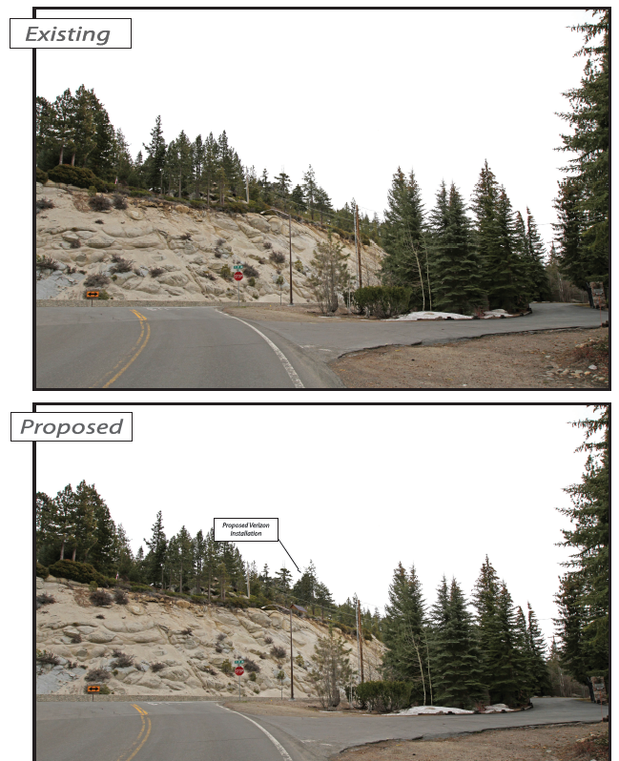
View from Lakeshore Blvd. - looking southeast

Slide 11
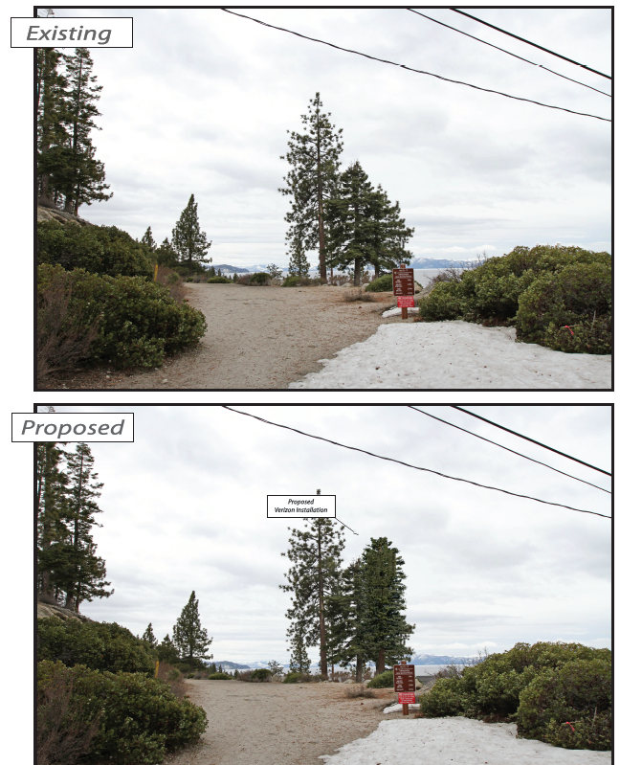
View from Tunnel Creek Rd. - looking southwest

Slide 12
Analysis
The applicant did looked at other locations however this site was deemed the best and met the requirements
The applicant states the antenna is needed to meet the significant gap coverage in the southeast section of Incline Village for Verizon
Per the applicant “federal law holds that limiting coverage to just one carrier to the exclusion of other carriers (because coverage then exists) constitutes an effective Denial of Service. While Verizon does provide some service in the area, coverage and capacity will be significantly improved with additions to the site.”

Slide 13
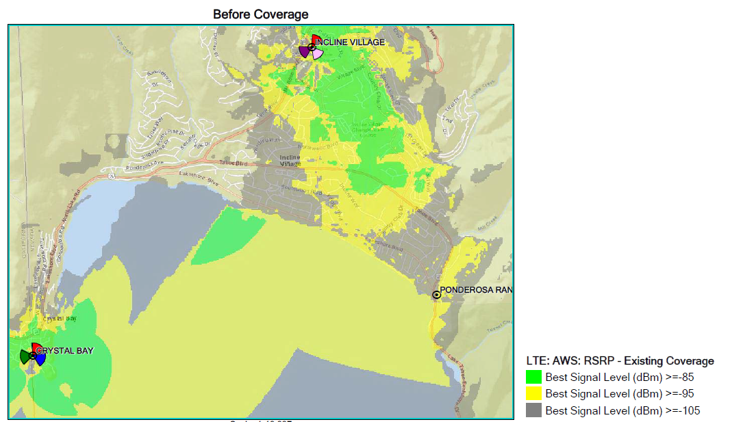
Coverage Map

Slide 14
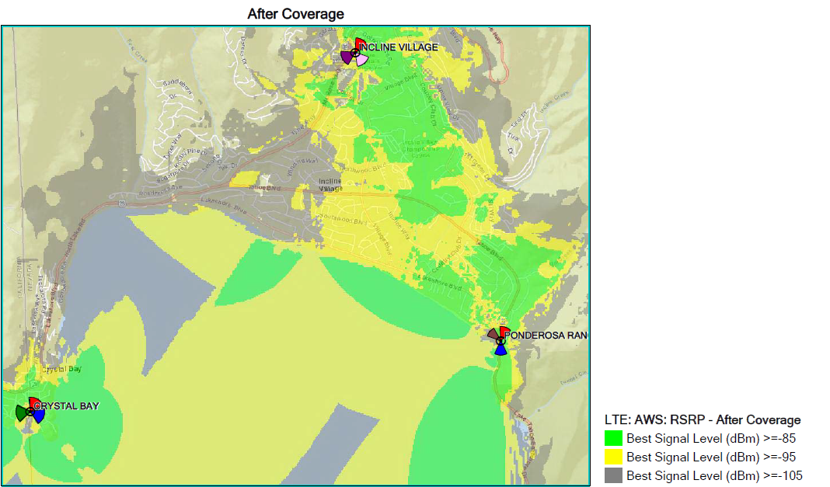
Coverage Map

Slide 15
Public Notice & CAB
33 parcels within 500 feet of the site were noticed
The Incline Valley CAB heard the item twice on May 6, 2019 and again November 4, 2019, the applicant made changed the location of the tower and equipment slightly and updated the application
The CAB made no recommendations, except to forward the CAB minutes
I have received phone calls with questions and an email in opposition that has been distributed to the Board

Slide 16
Reviewing Agencies
Various agencies reviewed the application, their comments are included in the staff report
Agencies with conditions, are included in the Conditions of Approval

Slide 17
Findings
WCC Section 110.810.30, Special Use Permit Findings:
  Consistency with Master Plan
  Adequate Improvements
  Site Suitability
  Issuance Not Detrimental
  Effect on Military Installation

Slide 18
Findings
Findings required by Section 110.324.75, for a telecommunications facility:
  That the communications facility meets all the standards of Sections 110.324.40 through 110.324.60 as determined by the Director of Community Development and/or his/her authorized representative;
  That public input was considered during the public hearing review process; and
  That the monopole or lattice tower will not unduly impact the adjacent neighborhoods or the vistas and ridgelines of the County.
  Staff analysis of required findings is provided in the staff report starting on page 20-21. Staff is able to make all of the required findings and is recommending approval

Slide 19
Possible Motion
I move that, after giving reasoned consideration to the information contained in the staff report and information received during the public hearing, the Washoe County Board of Adjustment approve, with conditions, Special Use Permit Case Number WSUP19-0006 for Verizon Wireless, having made all five findings in accordance with Washoe County Code (WCC) Section 110.810.30 and all three findings in accordance with WCC Section 110.324.75 and waiving landscaping requirements per WCC Section 110.412

